Slide 1
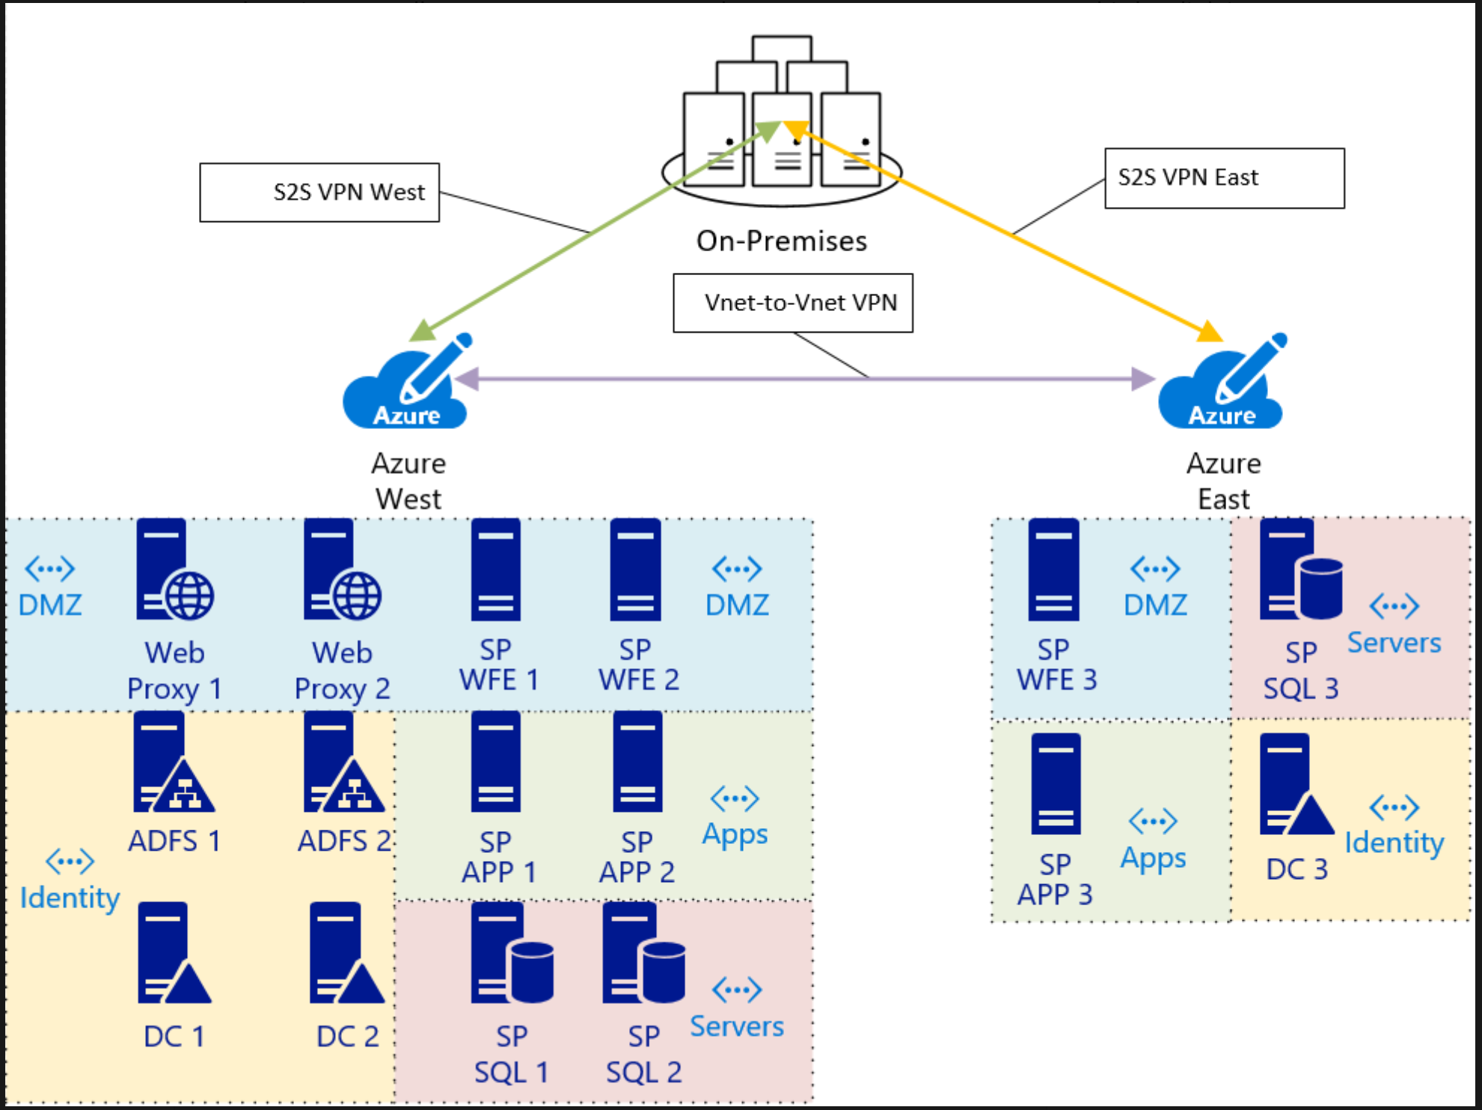
Current Azure Architecture

Slide 2
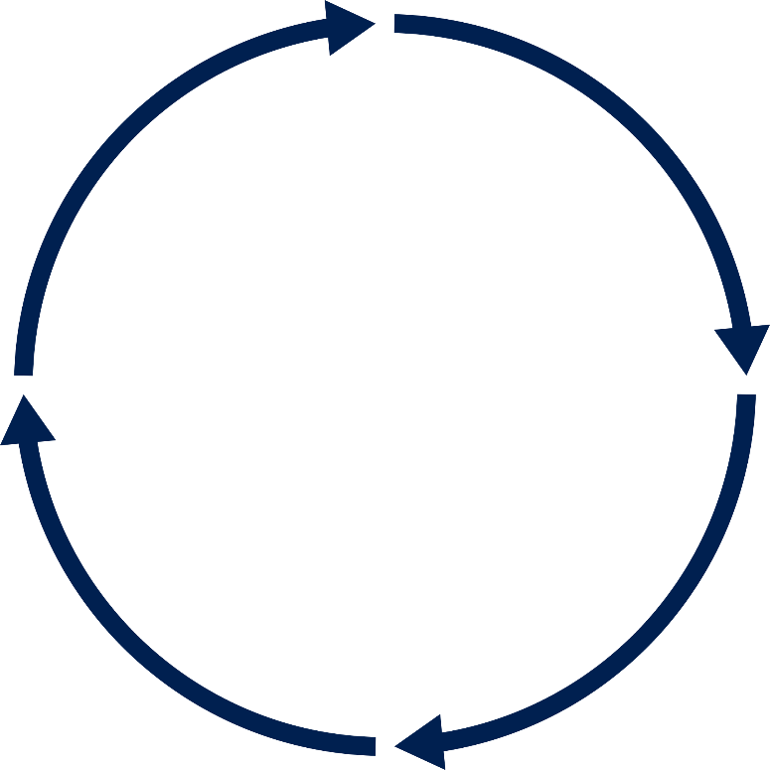
Cost Optimization Process
Resource efficiency
Review: Assess the effects and continue the process regularly
Gather: Identify opportunities to improve
Assess results
Identify
Use tools
Examine data
Analyze: validate that automated recommendations make sense
Advise: Implement savings changes

Slide 3



How can we save money?
Reduced Waste
Moved up the Azure stack
Engineered for Cloud
(ADO)
Notes:
Internally at Microsoft, how we saved on our costs were to look into 3 main focus areas, and those were:
Waste: identify and remove all the waste in the environment
Move as many of our workloads up the Azure stack as possible, taking advantage of PaaS related services wherever possible
And finally, to shut down old non-relevant applications and services and migrate them / engineer for the cloud…..ie, moving to Serverless computing instead, and removing all requirements for traditional hardware (or what we call “traditional IT”)….
If you noticed (or remember) we changed our name to Core Service Engineering, there is no more IT at Microsoft…..and by changing our name to Engineering, we now Engineer for the cloud…changing the mindset, the way we develop and supply our services

Slide 4
Reduce Waste
Unattached Disks
https://docs.microsoft.com/en-us/azure/virtual-machines/windows/find-unattached-disks
Azure Hybrid Benefit for Windows and SQL servers (upto 40% additional savings)
Azure Advisor Recommendations - Right Sizing\shutdown underutilized compute
https://docs.microsoft.com/en-us/azure/advisor/advisor-cost-recommendations
Once you implement a recommendation, it can take up to a day for Advisor to recognize that.
Reserved Instances (RI)
https://docs.microsoft.com/en-us/azure/advisor/advisor-cost-recommendations#buy-reserved-instances-for-several-resource-types-to-save-over-your-pay-as-you-go-costs
Optimize workloads by using RI (Shared or Single)
Environments: DEV\STG\QA\ 24/7? Auto shutdown, Auto Scale, Burstable SKUs

Slide 5
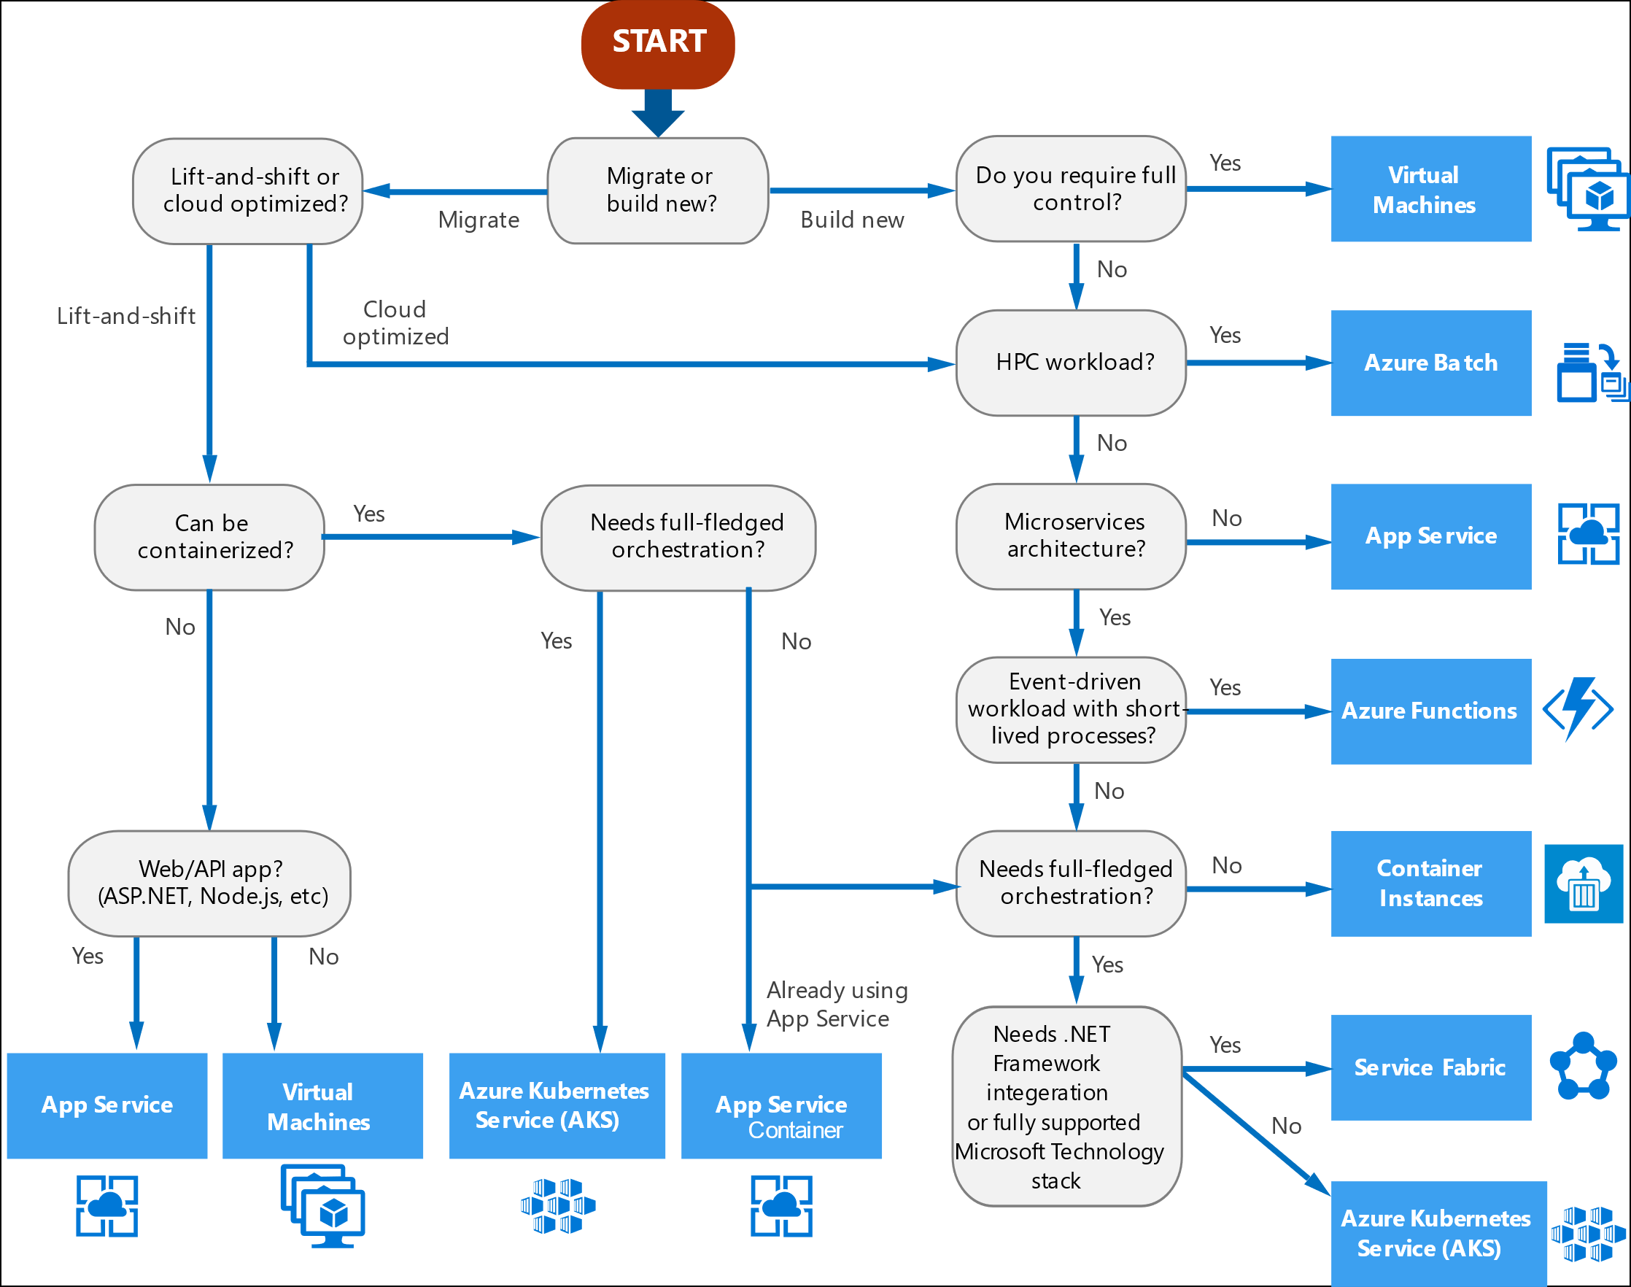
Choose the right Azure compute service
aka.ms/computedecisiontree
Notes:
Another great way to cost optimize that Maersk talked about is re-architecting your workload. As your environment changes, so should your cloud. Here’s an example of the kind of guidance we provide to help you make strong architectural decisions. Compute is a particularly important area to get right because it drives a lot of your workload costs and architectural decisions. For example, let’s say you’re doing a lift and shift, it can’t really be containerized, and it’s a web app. Well, then App Service is probably the right choice. We’ll provide a link to where you can find this guidance later on.

Slide 6
Choose the right Azure compute service
6
aka.ms/computedecisiontree
Notes:
Another great way to cost optimize that Maersk talked about is re-architecting your workload. As your environment changes, so should your cloud. Here’s an example of the kind of guidance we provide to help you make strong architectural decisions. Compute is a particularly important area to get right because it drives a lot of your workload costs and architectural decisions. For example, let’s say you’re doing a lift and shift, it can’t really be containerized, and it’s a web app. Well, then App Service is probably the right choice. We’ll provide a link to where you can find this guidance later on.

Slide 7
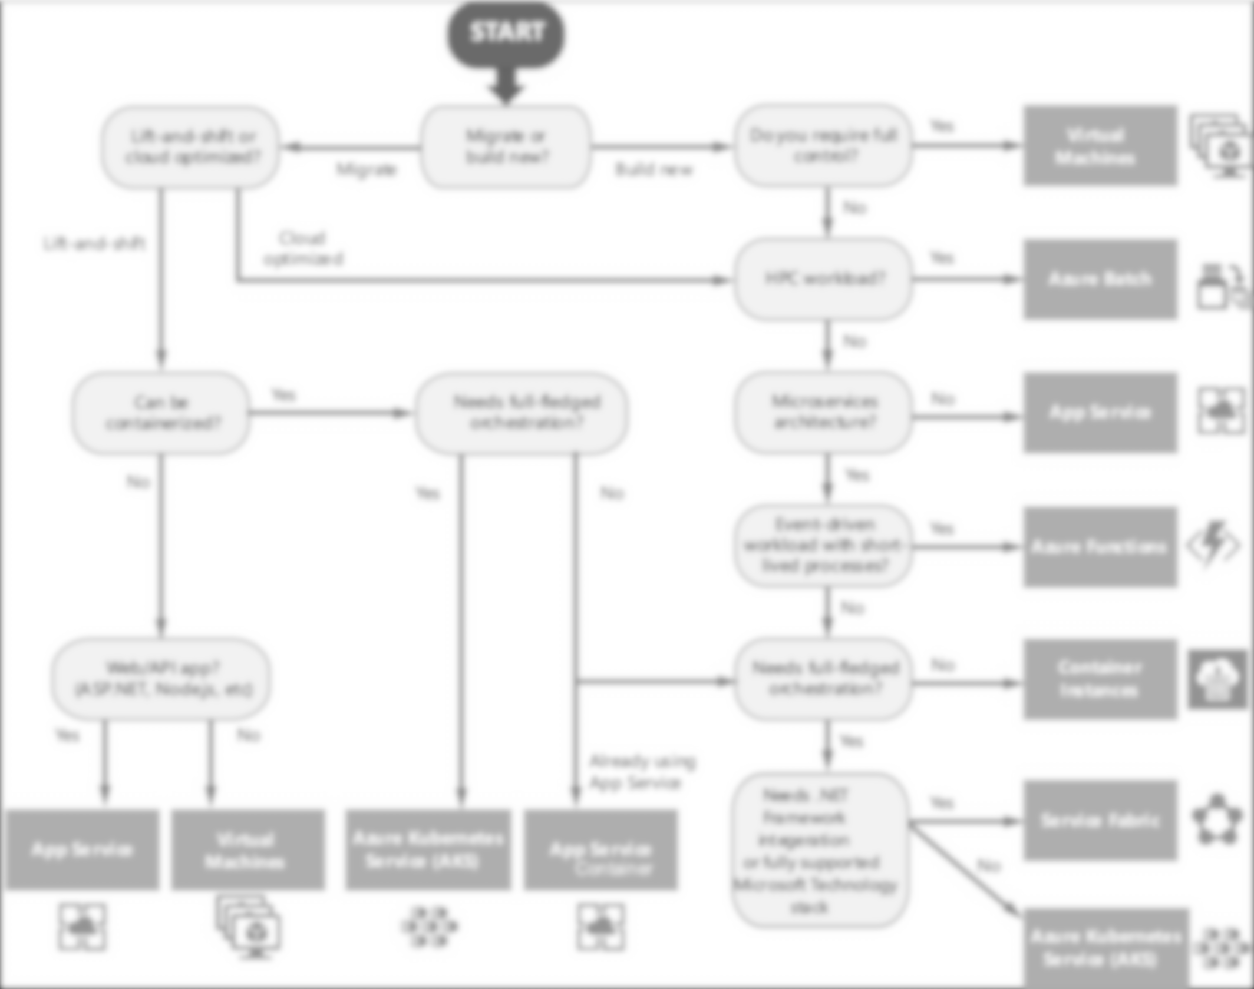


Slide 8


Slide 9


Slide 10


Slide 11
Choose the right Azure compute service
aka.ms/computedecisiontree
Notes:
Another great way to cost optimize that Maersk talked about is re-architecting your workload. As your environment changes, so should your cloud. Here’s an example of the kind of guidance we provide to help you make strong architectural decisions. Compute is a particularly important area to get right because it drives a lot of your workload costs and architectural decisions. For example, let’s say you’re doing a lift and shift, it can’t really be containerized, and it’s a web app. Well, then App Service is probably the right choice. We’ll provide a link to where you can find this guidance later on.

Slide 12
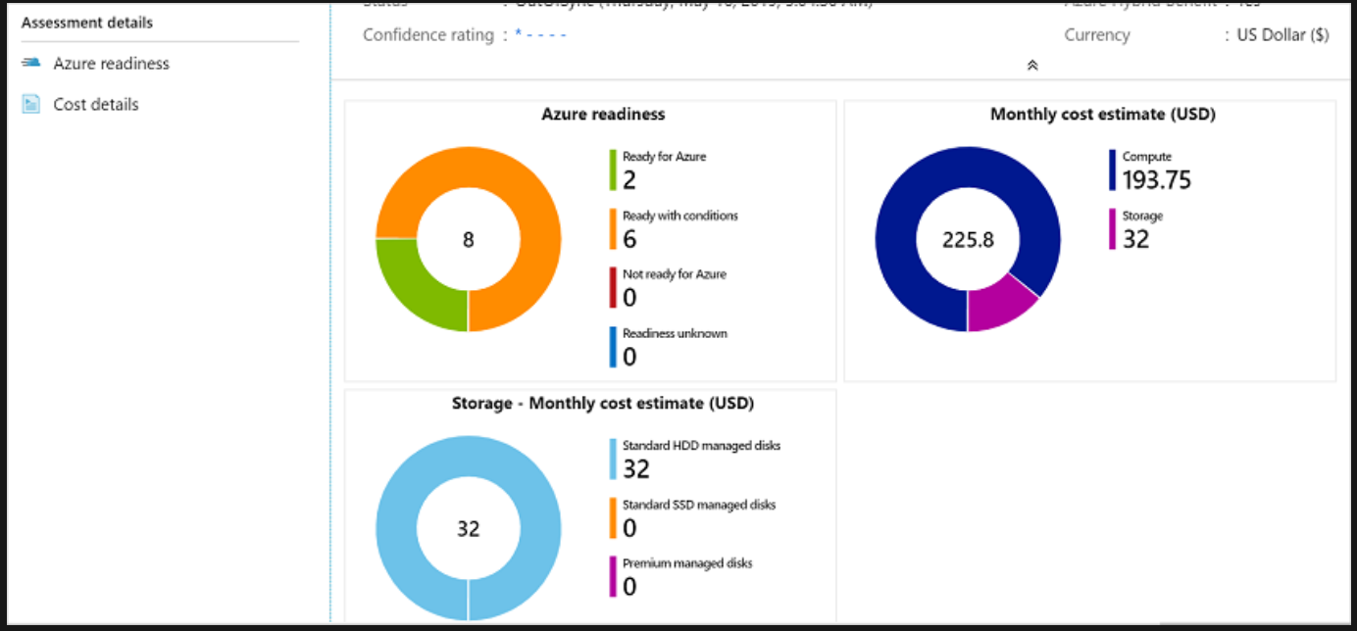
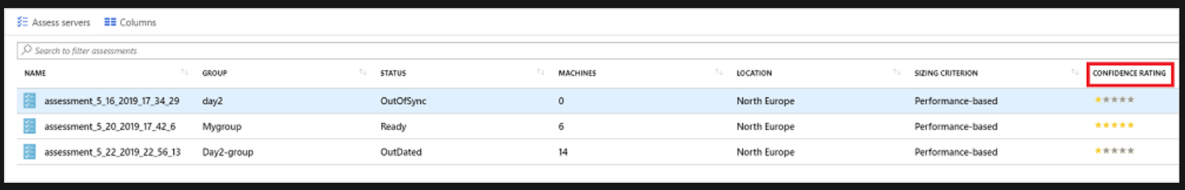
Azure Migrate tool – (onboarding assistance Sample)
Notes:
Azure Migrate recommends a VM size and cost estimates for VMs in the assessment.
Ready with conditions: Shows issues and suggested remediation.
Not ready for Azure: Shows issues and suggested remediation.
Readiness unknown: Used when Azure Migrate can't assess readiness, due to data availability issues.
Review the monthly compute and storage costs. Costs are aggregated for all VMs in the assessed group.
Cost estimates are based on the size recommendations for a machine, and its disks and properties.
Estimated monthly costs for compute and storage are shown.
The cost estimation is for running the on-premises VMs as IaaS VMs. Azure Migrate Server Assessment doesn't consider PaaS or SaaS costs.
The confidence rating helps you estimate the reliability of the size recommendations provided by the assessment.
The confidence rating is based on the availability of data points needed to compute the assessment.

Slide 13
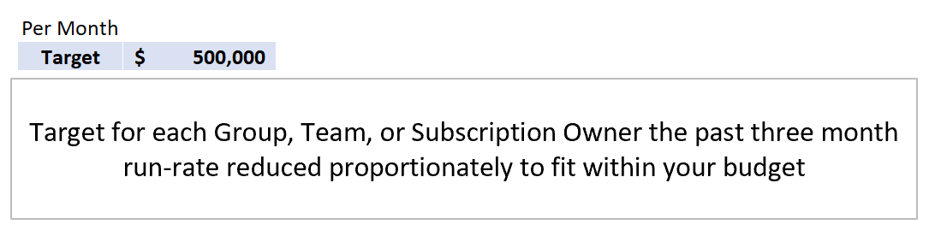
Azure Target (Sample)
Target is the estimated Monthly Budget per Team
Variance is the savings per month

Slide 14

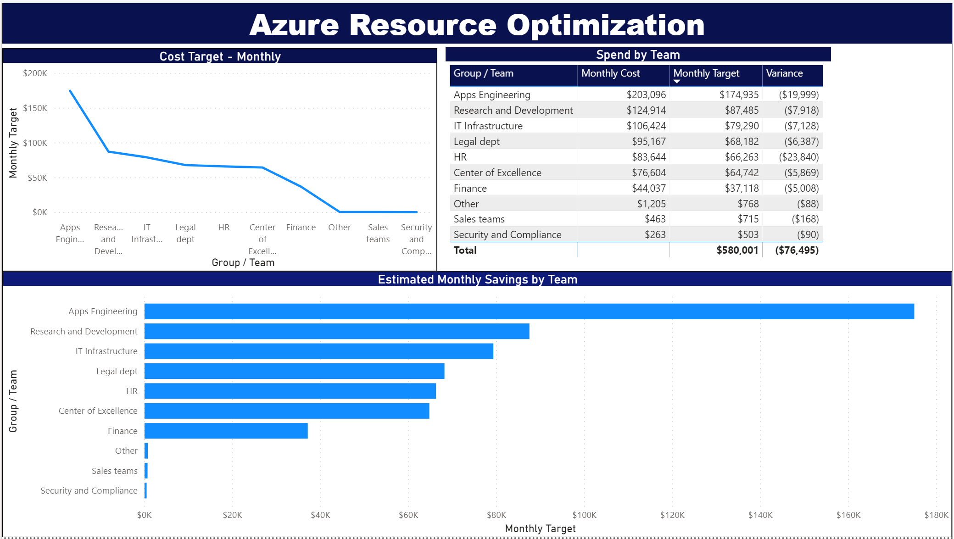
Wall of Fame – Live Site Reviews (Sample)
Notes:
The following 3 slides are Optional – this is a section for those customers who do not have or have not created a rhythm of accountability with regards to Cost Optimization. This shows EXAMPLES of best practices we have adopted internally at Microsoft.
This slides reviews the “Wall of Fame” a best practice deployed in CSEO, where cost and optimization/modernization efforts were reviewed weekly at the Group level in what was known as a “Live Site Review” process.
This supported, and followed the Agile process – Sprints every 2 weeks, with a Sprint review, in that review cost optimization was added to ensure the group:
Drive towards the groups’ cost goals
to ensure the teams were maintaining sustainable practices
This screenshot (an example of Contoso): shows how you can bring “Accountability” to the Cost / Optimization process by openly showing where teams are in their goals and celebrating those teams who are achieving (overachieving).

Slide 15
ACM PowerBi Template App (Demo)
Cost Management App (microsoft.com)

Slide 16
The Direct APIs for Cost Optimization
In the event your customer cannot not share the reports with you due to data sovereignty regulations, or does not have access to ACM PowerBi App, due to lack of EA Admin authority, the customer can still download all the reports directly using the following APIs
Table reference | Description
AutoFitComboMeter | Data included in the app to normalize the RI recommendation and usage to the smallest size in the instance family group.
Balance summary | Summary of the balance for Enterprise Agreements.
Budgets | Budget details to view actual costs or usage against existing budget targets.
Pricesheets | Applicable meter rates for the provided billing profile or EA enrollment.
RI charges | Charges associated to your reserved instances over the last 24 months.
RI recommendations (shared) | Reserved instance purchase recommendations based on all your subscription usage trends for the last 7, 30, or 60 days.
RI recommendations (single) | Reserved instance purchase recommendations based on your single subscription usage trends for the last 7, 30, or 60 days.
RI usage details | Consumption details for your existing reserved instances over the last month.
RI usage summary | Daily Azure reservation usage percentage.
Usage details | A breakdown of consumed quantities and estimated charges for the given billing profile in the EA enrollment.
Usage details amortized | A breakdown of consumed quantities and estimated amortized charges for the given billing profile in the EA enrollment.

Slide 17
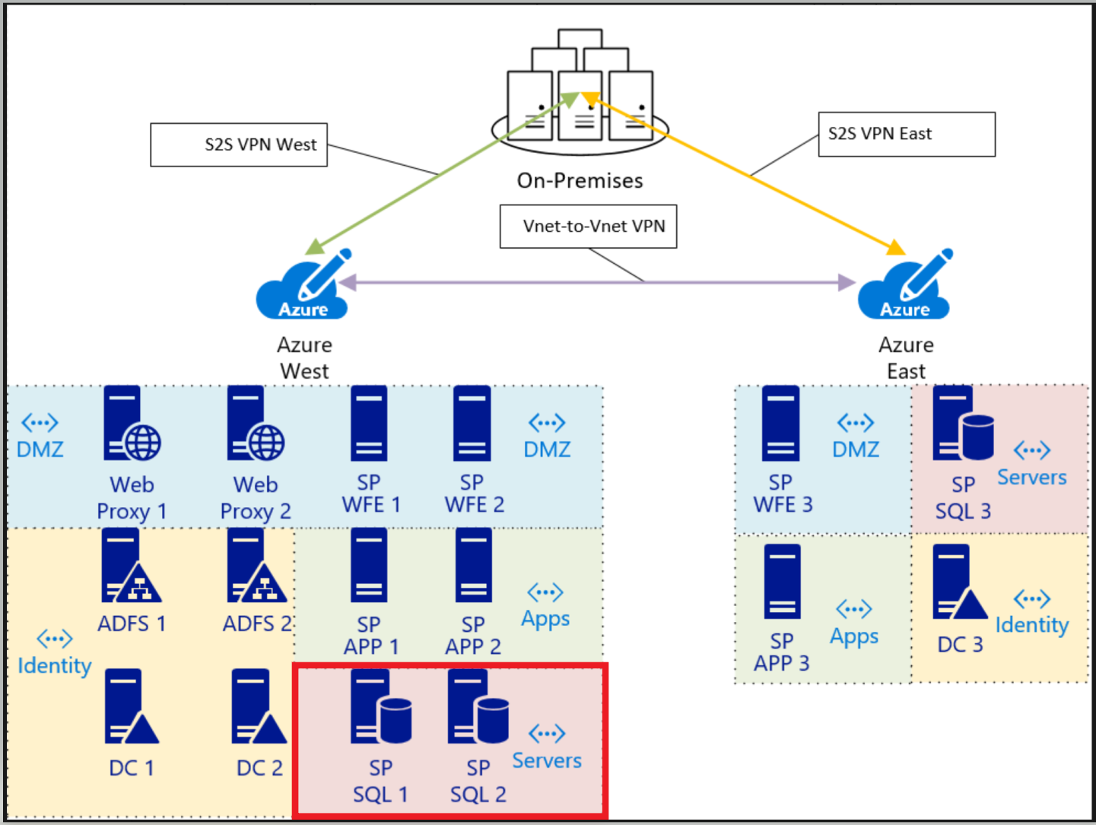
Current Azure Architecture

